Slide 1
Virtual Climbing Plants Competing for Space
Paper by Beďrich Beneš & Erik Uriel Millàn
Presented by Alan Litteneker for CS275

Slide 2
Virtual Plants
Very simple question . . .
Can we virtually mimic real plants?
Highly complex natural systems, interacting in counterintuitive ways
Incredible variation of form and structure
True simulation would require infeasible cellular morphology modelling

Slide 3
Lindenmayer Systems
Early models lacked real complexity, until . . .
A botanist named Aristid Lindenmayer proposed a formal language system in 1968
A small number of simple rules can allow for a high level of complexity and variation
Can describe anything from Algae to Sierpinski Triangles to Oak Trees

Slide 4
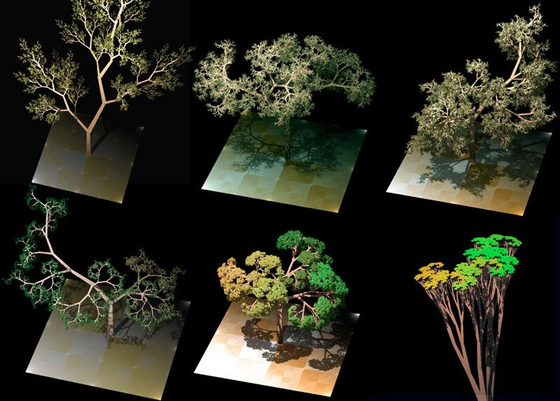
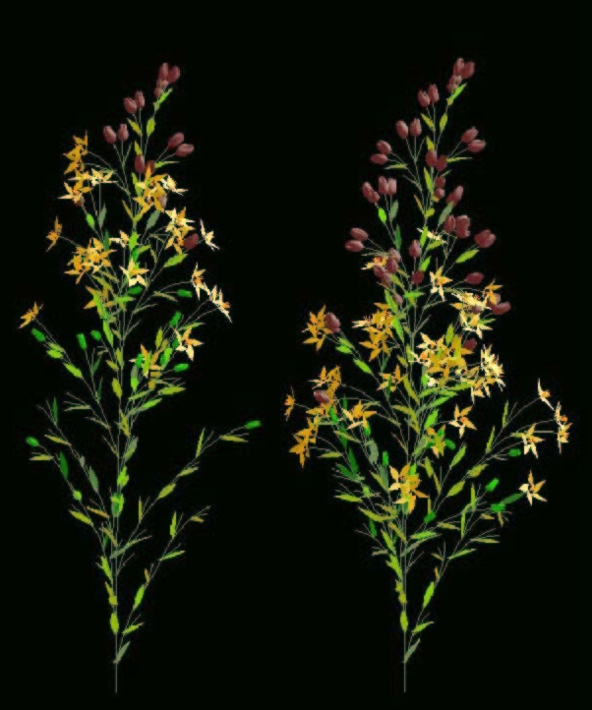
L-system Examples

Slide 5
Open L-Systems
Developed by Przemyslaw Prusinkiewicz
Allow for interaction with environment by adding general query to global data structures
For example:
Limited water, nutrients, etc. in ground
Competition for light and space
Avoidance of external and self intersection
Structural support

Slide 6
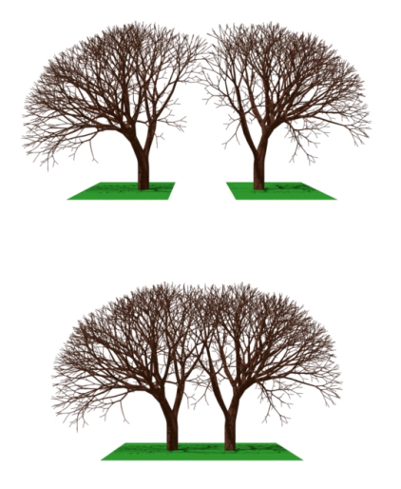
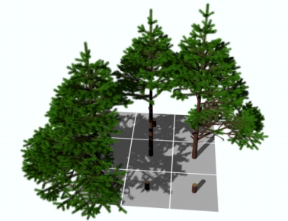
Open L-system Examples

Slide 7
Problems with L-Systems
Non-intuitive for human programming
Difficult to determine structure of final shape from initial language and state
Almost impossible to find an L-system to describe a particular structure
Programmatically complex to allow any interaction with environment
Computationally expensive

Slide 8
Is there something “better”?
Inherent difficulty with L-systems suggests domain specific simplifications
If we are interested in a specific type of plant, can we develop a simpler system specifically for that type of plant?
Can a more specialized system allow easier interaction with the environment?

Slide 9
Particle Plant Systems
Proposed in the mid 80’s
Generally plant type specific
Describes plant as connected graph of simple particles
Growth comes from human programmed data structure production rules
Easier integration with environment system

Slide 10
Particle Systems
Pros:
Easy to program
Cheap(er) to run
Simpler environment interaction
Cons:
Limits possible complexity and variation
Doesn’t sound as cool

Slide 11
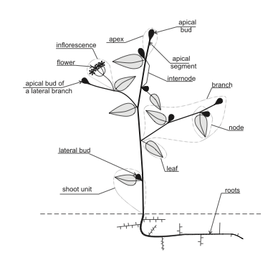
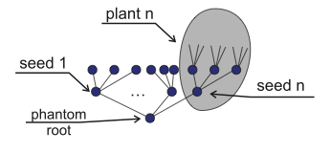
A Useful Simplification

Slide 12
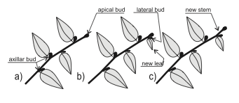
Basic Process
Initial apex particles are seeded
Random walk to find new optimal bud position according to fitness function
Ensure new positions do not intersect with plant or existing environment
If unable to grow, perform traumatic reiteration
Occasionally seed lateral branches as fall backs
Go back to step 2, and repeat

Slide 13
Algorithm Specifics
Put all seeds into the list of active buds
While the list is not empty:
Perform the following actions in parallel for every bud from the list of active buds:
Generate n sample positions
Evaluate the fitness function for every sample
Pick the best sample
Is the best position viable? YES: continue growing
Grow there
Sometimes generate lateral buds and do not put them into the list of active buds
Put every i-th lateral bud into the list of active buds to achieve branching
NO: perform traumatic reiteration
Remove the bud from the list of active buds
Find the closest bud down on the same branch
Put this bud into the list of active buds

Slide 14
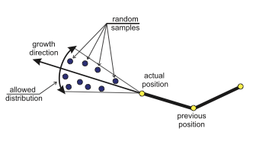
Fitness Function
Directed random walk attempts to:
Maximize amount of light received by node
Sum of number of light sources visible to bud point
Tested using single ray tracing through scene
Minimize distance to non -plant objects
Optimize structural support

Slide 15
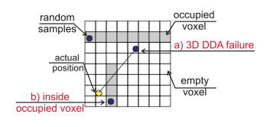
Collision Detection
High resolution voxel map
Voxelize the initial environment
Add to voxel map as plant grows
DDA line traversal for collision detection

Slide 16
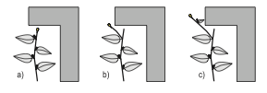
Traumatic Reiteration
Growth in a particular direction can result in lack of space for further growth
Traumatic Reiteration solves this by promoting a lower lateral bud to a growth bud whenever a growth node dies
Simplest mechanism for growth optimization

Slide 17
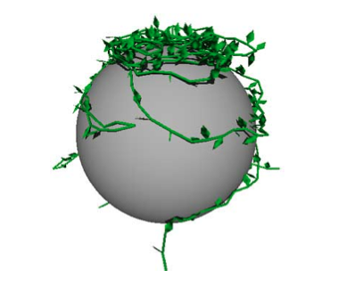
Pictures!
Maximizing Light Coverage
on a Complex Surface

Slide 18
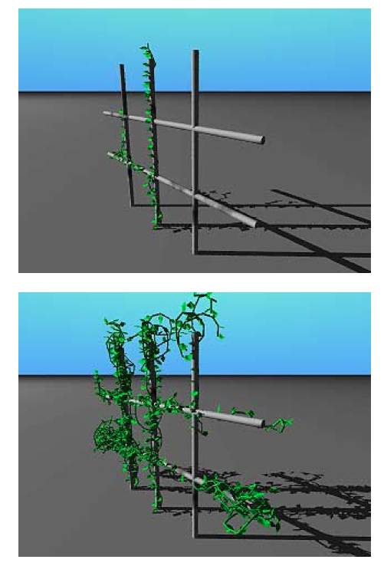
Pictures!
Notice problems with lack of gravity simulation.

Slide 19
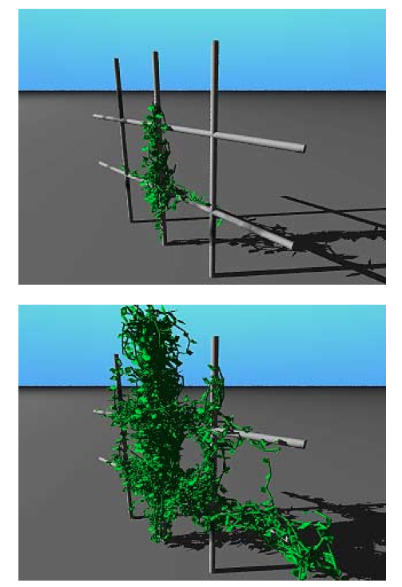
Pictures!

Slide 20
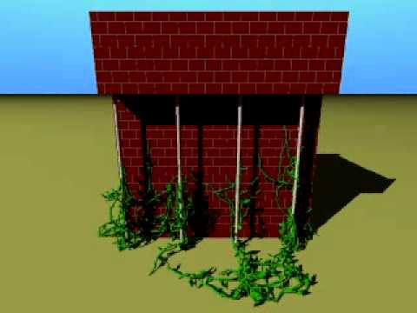
Video!
https://youtu.be/F2aYwU23XBY

Slide 21
Questions
Questions?
The End!

